Slide 1

Interview Preparation Points for Requirement Engineering
System Side
ASPICE Module (V cycle)
SDLC (Software Development Life Cycle)
SYS5
ALM
DOORS
Microsoft Visio
Issue Management (GIMS, PITS, RAR)
ISO26262
DFMEA
Manufacturing Side
Engineering Change Request (ECR)
Engineering Change Order (ECO)
DFA, FMEA
Line Balancing & Takt Time
Value Stream Mapping

Slide 2
ASPICE
Automotive Software Process Improvement and Capability dEtermination
- Created for
It was created to assess the performance of the development process.
It defines the best practice and process to ensure highest Quality of Embedded Automotive Software development.
ASPICE V Model
System Engineering Process Group
SYS1
Requirement Elicitation
Gather information from stockholders.
Basic for defining work package lifecycle.
SYS5
System Qualification Test
Evaluate Integration system & validate it as per our system requirements.
SYS2
System Requirements Analysis
Process the stakeholders requirements into systems requirements.
Which helps to design system.
SYS4
System Integration & Integration Test
Integrates the components identified to create system as per architecture.
Also test & confirm.
SYS3
System Architectural Design
Establish system architectural by creating component & interconnecting through interface.

Slide 3
4 Types of Level
Stockholders Lvl
Vehicle Lvl
Systems Lvl
Component Lvl
Downstream requirement actually filling upstream requirement.
Automotive V Model
4 Types of Verification and Validation
Component Verification (Test)
System Validation
Vehicle Validation
Operational Validation (Acceptance Test)
4 Types of Requirements
Stockholders Req
Vehicle Req
Systems Req
Component Req
Supplier Side
Requirements send to supplier for software development, develop component functionality.
Develop control software, Develop C code
Provide controller with updated software.
After dev of sw they test sw that is component design verification. They provide report that is CVVR (Component Validation and Verification Report)

Slide 4
Component Functional Req. (Specifies what each component involved in your system, specifies component functional requirement for achieving system level requirement.)
VF
Technical Safety Requirements
Stakeholder Req
(Need Base Requirements)
Bulletins
Series card
Standard document
4 Types of Requirements
Vehicle req.
(Understand stakeholder requirement, develop functional objective)
Functional Objective
Cyber Security Requirements
Vehicle Level Item
HARA
Safety Goals
System Req.
(Take Functional Objective, Start creating System architecture & System level Requirement, comprise Logical Architecture & Functional Requirement)
VF(Sys & comp requirements)
System Level Definitions
VFD
Systems Diagram

Slide 5
Operational Validation (Acceptance Test)
Once various level of testing is done.
Component Verification (Test)
Verifies desktop simulation
4 Types of Verification and Validation
Vehicle Validation
Vehicle integration Team Test Vehicle and check functional objective are meet in the vehicle or not.
If not, they raise issue in GIM.
System Validation
HIL
Vehicle validation
PWB check software as per our System requirements.
Check feature is correctly working or not.

Slide 6
Stakeholder Level
Bulletins
Series card
Standard document
Component Level
VF(Sys & comp requirements)
Technical Safety Requirements
Artifacts as per Level
System Level
VF(Sys & comp requirements)
System Level Definitions
VFD
Systems Diagram
Vehicle Level
Functional Objective
Cyber Security Requirements
Vehicle Level Item
HARA
Safety Goals

Slide 7
SDLC
Concept Phase
Requirement Phase
Design
&
Development Phase
Verification & Validation Phase
Concept Phase-
Benchmarking study, Review Existing Portfolio, Talk with customer & Stakeholders try to build concept. Result is successful.
Requirement Phase-
All type of requirements developed in requirement phase.
Design & Development Phase-
Requirements Send/release to the supplier/software team. Supplier analyse the requirements and start development of the software.
Verification & Validation Phase-
After software development supplier/software team send software. Test the all requirements are satisfied or not.

Slide 8
System Engineer work cycle.
Program Approve
0A
1A
2A
Start for requirement gathering.
Requirements analysis & understanding.
Draft VF for 0A release.
Athena Check (Formal & Integration Error)
Develop requirements and do sanity check.
Draft in 0A release folder.
After 0A release
System DFMEA development
System Architectural development.
System Functional, Non-Functional, Diagnostics requirement development.
1A release design review.
Athena Check (Formal & Integration Error)
Draft in 1A release folder.
After 1A release.
Analyse & Understand the RARs.
If modification required in released VF raise CR(Change Request)
Update requirements.
Draft VF in CR folder.
Send back to the supplier.
If modification doesn’t require then simply need to provide resolution in EE Validation portal.
After 2A release.
Analyse & Understand the RARs.
If modification required in released VF need to go through risk mitigation.
Present VF modification requirements.
After approval in risk mitigation raise CR.
Update requirements.
Draft VF in CR folder.
Send back to the supplier.
If modification doesn’t require then simply need to provide resolution in EE Validation portal.
After 1A & 2A release requirements sends to the software team for development of sw.
Supplier Analyse & Understand the requirements.
If they have some issue/concern they will log RARs in EE validation portal. (Communication bridge)

Slide 9
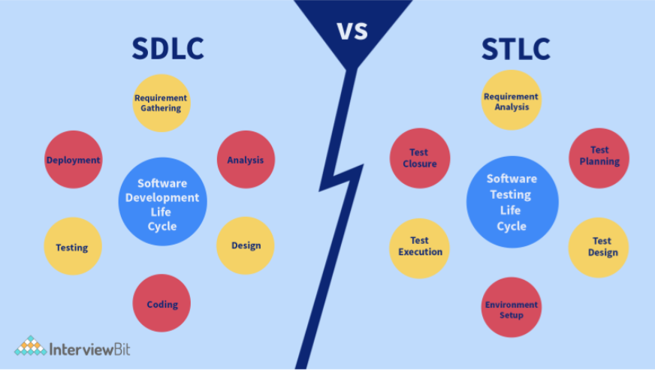
Software development Life Cycle
Software Testing Life Cycle
SDLC aims to manage the entire process of software development from start to finish and to deliver a quality product that meets customer needs.
The focus is solely on test development and helps to make the testing process more sophisticated, consistent, and useful.

Slide 10
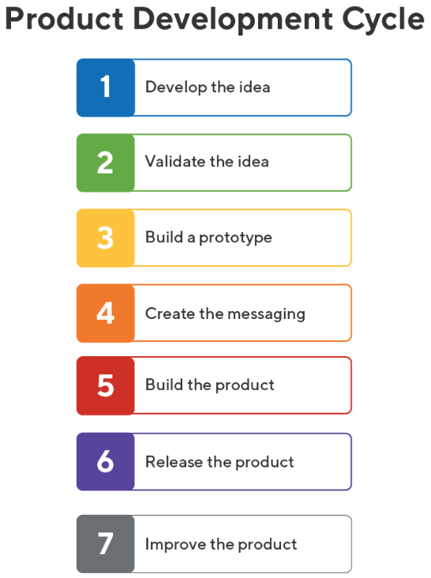
This is the brainstorming stage. The product team looks for ways to solve problems for their user personas. During this phase, the team will generate several product ideas.
By the end of the first stage, the team will have a long list of product concepts. The goal now is to narrow the list to one product or feature worth pursuing. There are several ways of screening ideas to learn which are the most viable.
For a company that develops software, the engineering team can create a very simple mockup of the application. They could even develop only a wireframe.
In parallel with building and sharing the prototype, the product team will be working with the marketing department to create the product’s market strategy. This will include:
Developing the product’s value proposition
Creating tools and materials for the sales department
Building marketing and advertising campaigns
After gathering focus-group feedback about its prototype or mockup, the team is now ready to build a minimum viable product (MVP).
After developing and testing its MVP, the company is now ready to launch it to the public. The MVP will help the company gain several important insights at once, including:
Finally, the product team will take real-world feedback from its early users to improve the product.

Slide 11
Types of Relay
Electromechanical relays
Solid-state relays
Time delay relays
Latching relays
High-current relays
Reed relays
Why Relay
Switching high current loads
Protecting switches
Providing isolation
Providing time delay
Relay
High Pressure Fuel Pump
Low Pressure Fuel Pump
The fuel pressure required while transferring fuel from the fuel tank to the injectors will depend on the specific fuel system design and the requirements of the engine.
In general, fuel pressure in a fuel injection system can range from about 30 psi to 100 psi or more. The pressure is typically regulated by a fuel pressure regulator, which maintains a constant fuel pressure within the system.
The fuel pressure required while transferring fuel from an auxiliary fuel tank to the main fuel tank will depend on the specific transfer system design and the requirements of the vehicle.
In general, the fuel pressure for this type of transfer is relatively low and typically does not exceed a few psi.
Fuel Pressure

